Slide 1
Treasury Investment Council
Meeting Date: November 21, 2024

Slide 2
Florida Economy &
Pool Balances

Slide 3
Florida Economy
July 2023 unemployment rate:
  U.S. 4.3%
  FL: 3.3% (366,500 Jobless persons)
General Revenue Forecast-- While total revenue collections exceeded expectations since the last conference by $1,085.7 million (or 2.3 percent), nearly 60 percent of the revenue gain was related to two sources: Corporate Income Tax and Earnings on Investments. For FY 2024-25 and FY 2025-26, the two-year combined increase is just over $2.0 billion.
Tourism -- After posting 3.6 percent growth in Fiscal Year 2023-24, the Conference expects another strong period of growth (4.6 percent) during Fiscal Year 2024-25, after which the annual growth rate moderates from 3.3 percent in Fiscal Year 2025-26 to 2.7 percent at the end of the forecast period.

Slide 4
FL Treasury Investment Pool Size
(total mkt. value)

Slide 5
State Net Receipts

Slide 6
State Operating Accounts

Slide 7
Non-State Operating Accounts*
* Subject to Floor Provision

Slide 8
Bond Accounts

Slide 9
Non-State Operating & Bond Accounts by type
Non-State Operating
Bond
Participant | 9/30/24 balance | % of Pool
Universities | $960,833,307.21 | 1.51%
Colleges | $123,304,551.05 | 0.19%
School Boards | $106,766,899.53 | 0.17%
Miscellaneous | $67,465,314.11 | 0.11%
University Component Units | $66,892,030.28 | 0.10%
State Component Units | $25,831,251.47 | 0.04%
College Component Units | $25,014,451.87 | 0.04%
Cities | $5,258,034.08 | 0.01%
Counties | $1,092,952.22 | 0.00%
Grand Total | $1,382,458,791.82 | 2.17%
Participant | 9/30/24 balance | % of Pool
Florida Housing Finance Corp. | $1,251,204,020.85 | 1.96%
Universities | $45,381,451.24 | 0.07%
University Component Units | $39,046,960.07 | 0.06%
State Component Units | $3,391.48 | 0.00%
School Boards | $544.20 | 0.00%
Grand Total | $1,335,636,367.84 | 2.10%
*Miscellaneous includes various associations, foundations, and finance corporations.

Slide 10
Summary of Macro Risks to the Investment Pool
Risk | Status | Risk Level
Florida Economy | Unemployment rate continues to be stable/low Population continues to grow, GR is Strong | Low
State Net Receipts | Continues to be strong/stable. | Low
Pool Balance | The total pool balance has remained relatively stable in the past year. Continue to watch legislative spending models. | Low
Non-State Agency SPIA | Non-State Agency Operating accounts continues to decrease and is now at 2.2%. | Low

Slide 11
Investment Pool
Distributed Income
Pool Average Balance (in billions)
Average Return (net of fees)
$24.7 | $23.3 | $24.1 | $26.5 | $32.8 | $48.3 | $62.6 | $64.2 | $64.9
1.45% | 1.66% | 2.32% | 3.16% | 1.61% | 0.73% | 1.64% | 2.90% | 4.27%

Slide 12
Securities Lending
Review

Slide 13
SECURITIES LENDING OVERVIEW
as of September 30, 2024
 | Market Value Securities on Loan | Market Value Collateral Received | Collateral Coverage | Market Value of Cash Reinvestments | NAV
Cash | $2,660,210,621 | $2,716,384,374 | 102.11% | $2,716,580,375 | 1.0001
Non - Cash | $5,363,520,572 | $5,503,745,780 | 102.61% | N/A | N/A
Total | $8,023,731,194 | $8,220,130,155

Slide 14
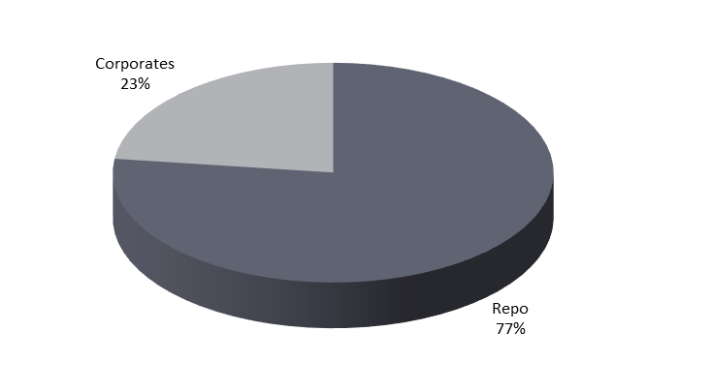
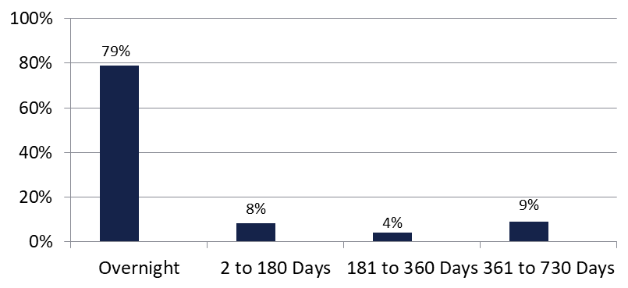

Securities Lending - Cash Collateral Portfolio As of September 30, 2024
Portfolio Characteristics
Credit Quality (S&P) | % of Cost | Cost (in mil.)
U.S. Govt. Securities* | 77.23% | $2,097.9
AAA | 0% | $0
AA | 7.85% | $213.3
A | 14.92% | $405.2
Total Market Value $2,716.4 million
NAV 1.0001
Yield (360 basis) 4.960%
WAM 61 days
* Includes Repos that are collateralized by U.S. Govt. Securities.
Asset Class
Final Maturity Schedule

Slide 15
Securities Lending Income

Slide 16
Economic and
Market Environment

Slide 17
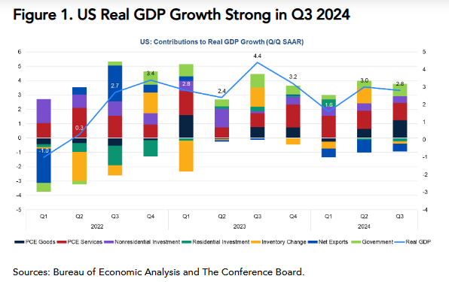
3rd Quarter GDP
Economy grew at an annualized rate of 2.8%.
Real consumption grew by 3.7% (ann.)
Uptick in Goods consumption

Slide 18
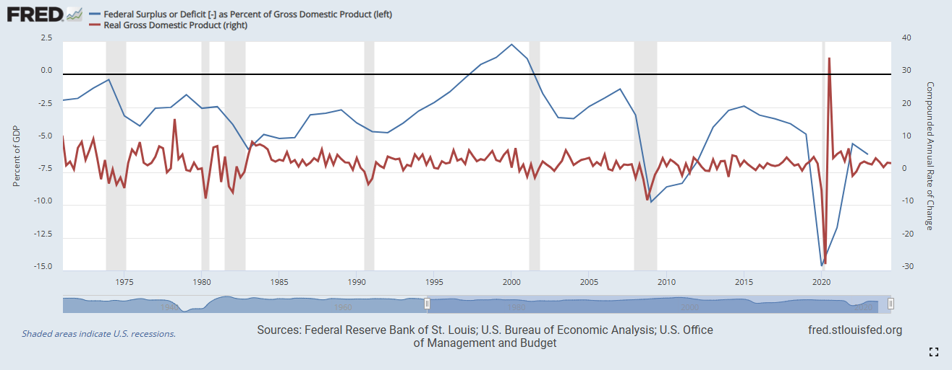
Paying More for the Same Growth

Slide 19
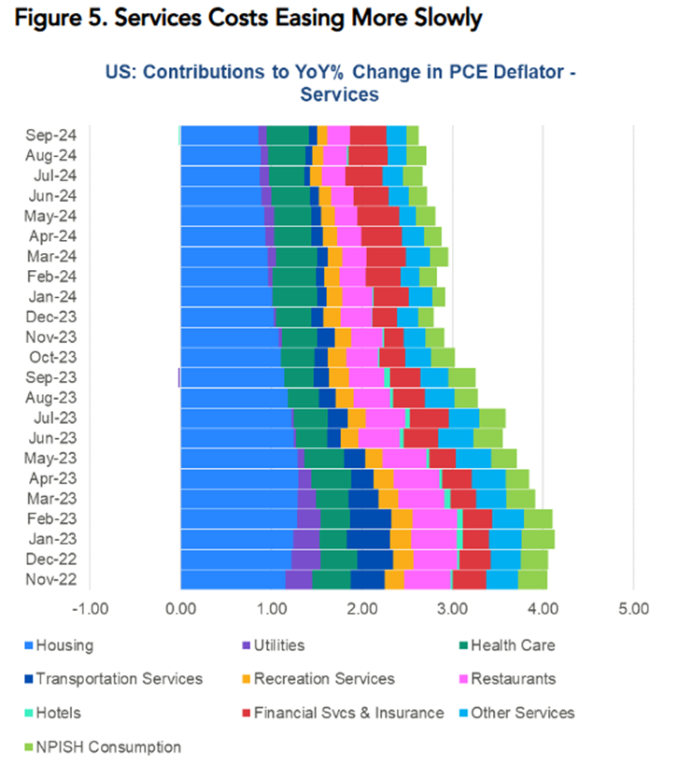
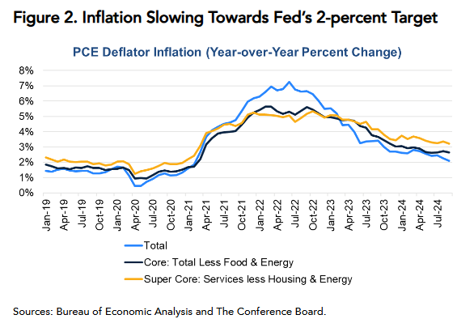
Inflation Slowing, Still Well Above 2% Target

Slide 20
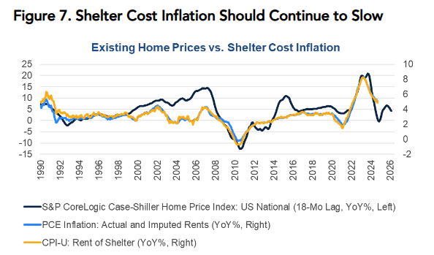
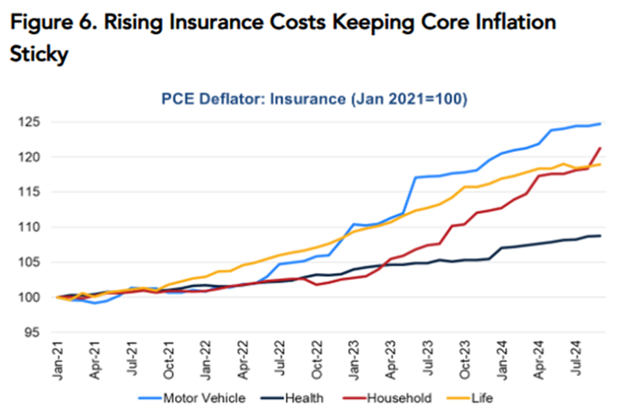
Inflation Headwinds & Tailwinds

Slide 21
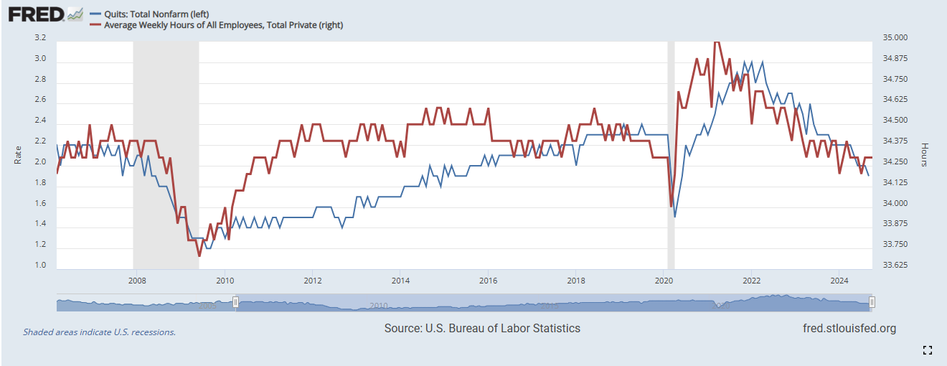
Labor Market Continues to Cool

Slide 22
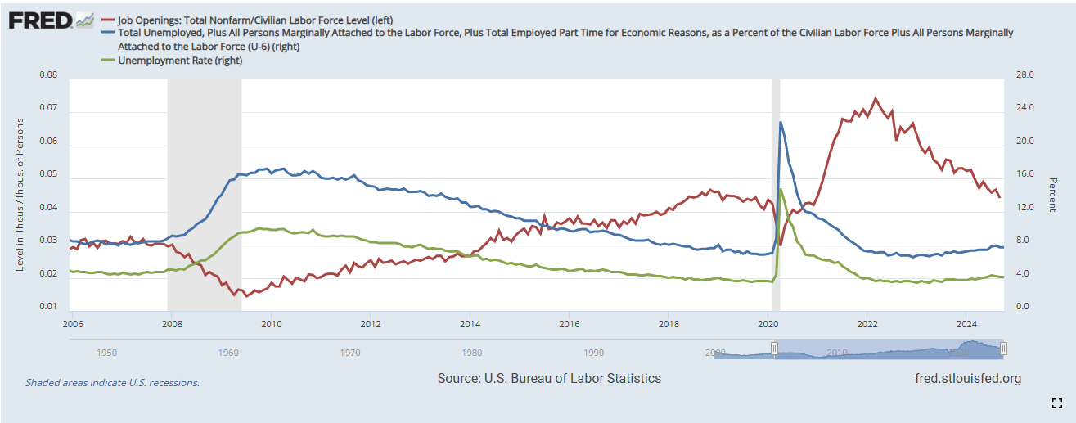
Job Openings Fall as UE Ticks Up

Slide 23
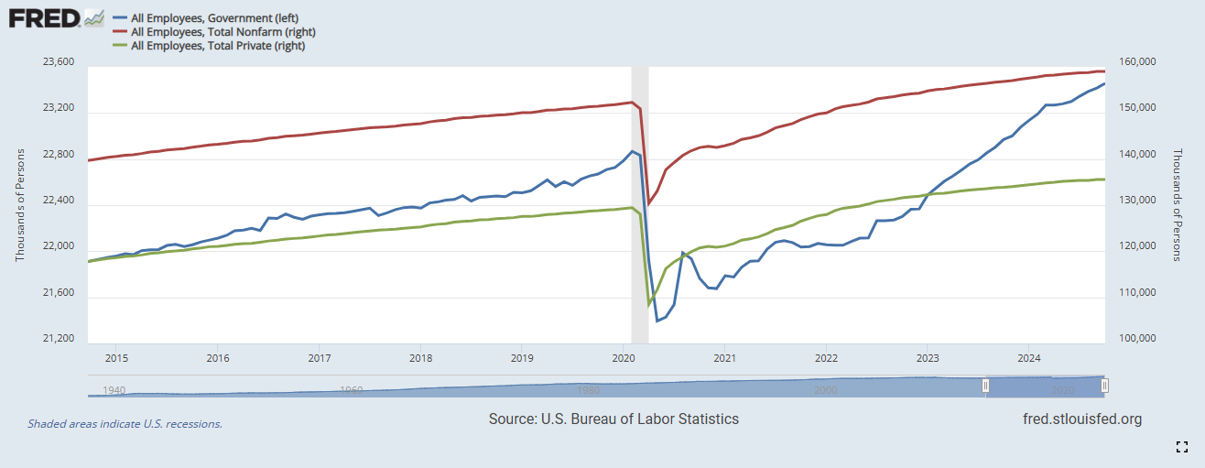
Govt Hiring Disproportionately

Slide 24
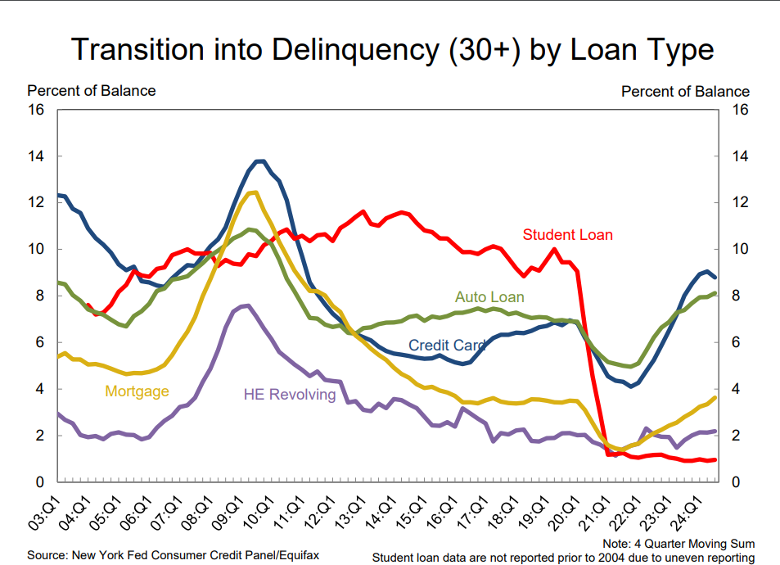
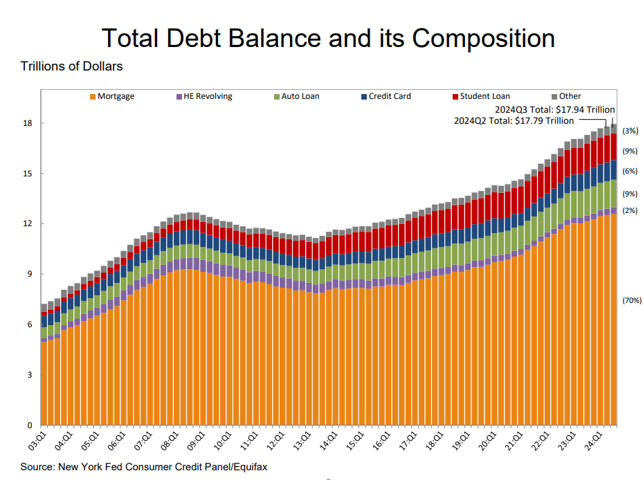
Delinquencies Continue to Climb

Slide 25
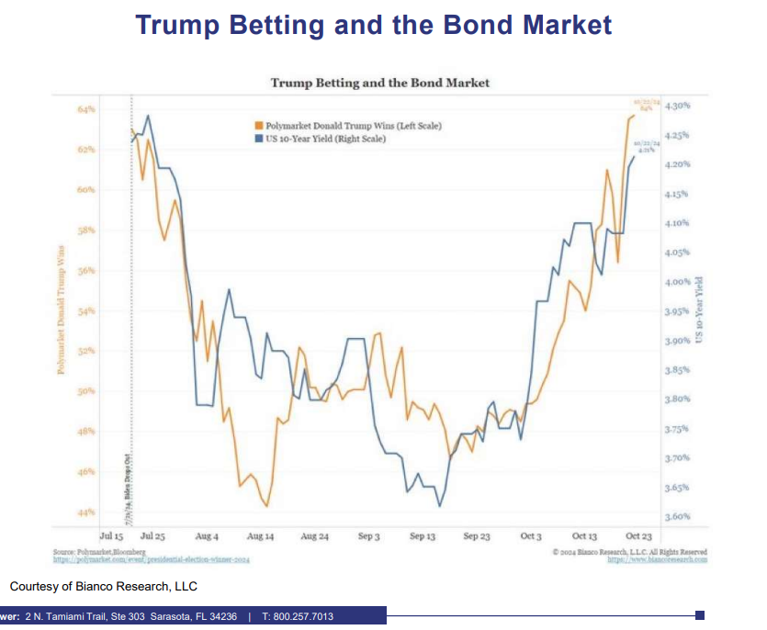
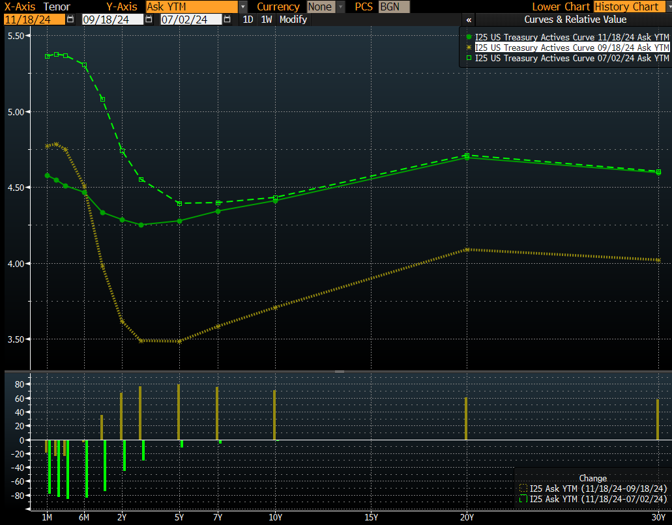
The ‘Trump Trade’

Slide 26
Benchmark Yields
November 2024 vs March 2024
Yield (%)

Slide 27
Fixed Income Yields and Spreads
September 2024 vs March 2024
Yield (%)

Slide 28
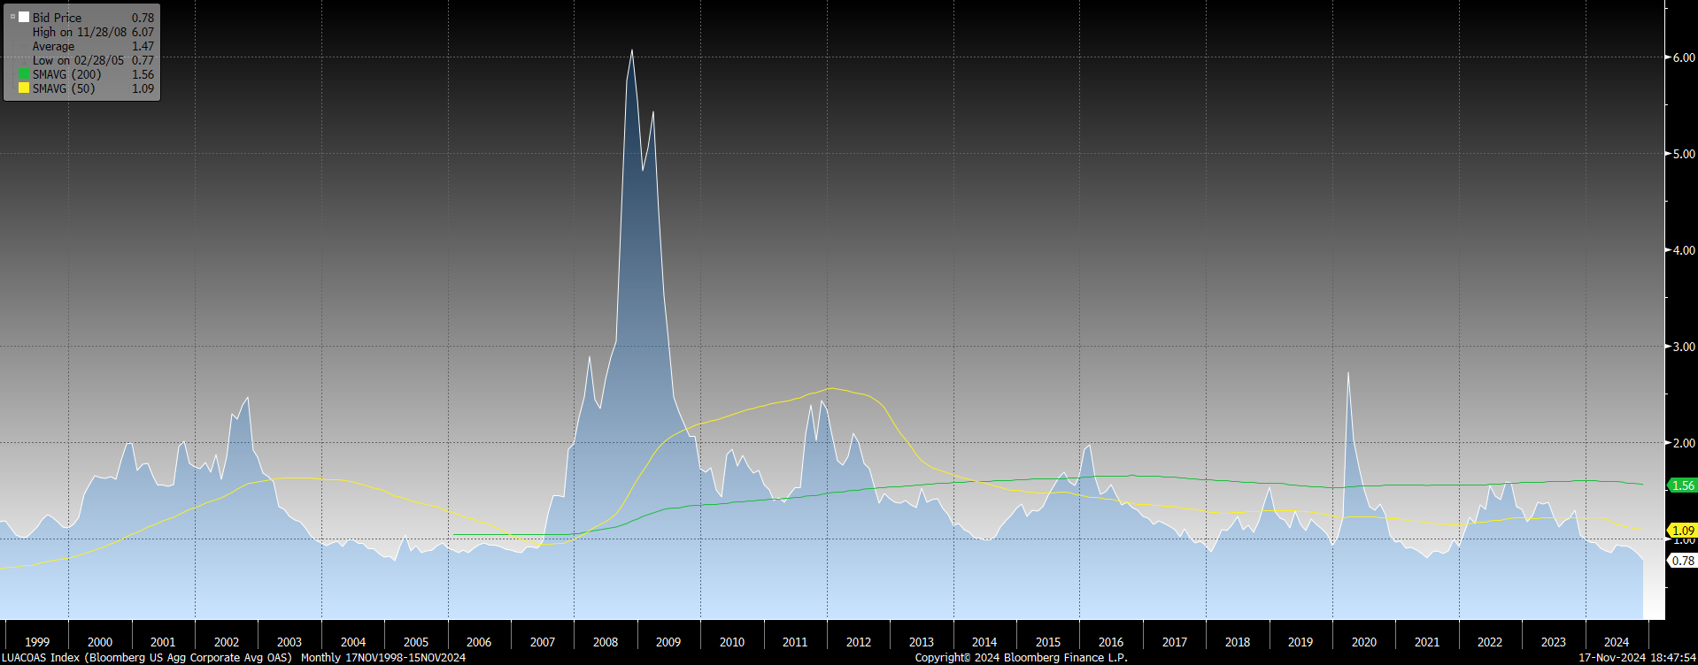
Bloomberg U.S. Corporate Investment Grade Index
*Chart Obtained from Bloomberg

Slide 29
Investment Pool
Review

Slide 30
Investment Strategy (Macro level)
Rates / Yield curve:
  Deficit and debt dynamics impacting inflation expectations which is pressuring the long end of the yield curve
  Expectations of rate cuts have been significantly reduced. Yield curve still relatively flat. Short to Intermediate part of the yield curve offers value.
Spread sectors:
  Trading at very tight levels. IG corporate balance sheets remain strong, and earnings / cash flows continue to beat expectations .
  Waiting for better reentry point to increase exposure to corporate sector. Favor ABS sector for Internal portfolios as the best way to add carry.

Slide 31
Investment Pool Allocation

Slide 32
Investments (Miscellaneous Updates)
Global Custody and Securities Lending Contract under a second six-month extension (Jan 26th, 2025).
Resumed the ability to invest in delayed settled mortgages in external accounts.
Working on adding more Repo counterparties for the Internal accounts.
Ended managers ability to realize excess losses (starting this month, realized losses are back to the maximum of 75% of income generated).
Completed the mid-year reviews with all our External Managers. Action taken on Watch List (discussed later).

Slide 33
Total Pool Characteristics

Slide 34
BBB & Lower Exposure
 | Exposure 3/31/2024 | Exposure 9/30/2024 | Limit
Ultra Short Duration | 0.3% | 0.3% | 3%
Short Duration | 2.8% | 2.4% | 7.5%
Intermediate Duration | 8.5% | 8.9% | 10%
Long Duration | 13.7% | 14.0% | 15%
Basket Clause
Statutes allow for 3% in
basket clause items

Slide 35
Unrealized Gains / (Losses) and
Net Asset Value
 | Ten-Year U.S. Treasury Yield | Total Amount of Unrealized Gains / (Losses) | Net Asset Value
9/30/2021 | 1.49% | $320 million | 1.01
9/30/2023 | 4.57% | ($3.4 billion) | 0.94
9/30/2024 | 3.78% | ($84 million) | 1.00

Slide 36
Pool Rating
Policy requirement: A+ or better using S&P rating matrix
S&P Rating as of September 30, 2024 = AA-f
Credit Score as of September 30, 2024 = 55.53 (AA-f) (vs. 62.09 Mar. 31, 2024)
S&P rating matrix
Maximum Score | Rating
18.49 | AAAf
37.49 | AA+f
58.49 | AAf
91.49 | AA-f
120.49 | A+f
184.49 | Af
290.49 | A-f
360.49 | BBB+f

Slide 37
Performance Review

Slide 38
U.S. Fixed Income Markets Returns
Q1 & Q2 - 2024
Treasuries
Spread Sectors
 | 3/31/2024 | 9/30/2024 | Period Change
3-month T-Bill | 5.371% | 4.627% | -74.4 b.p.
2 Year T-Note | 4.621% | 3.642% | -97.9 b.p.
5 Year T-Note | 4.213% | 3.559% | -65.4 b.p.
10 Year T-Note | 4.201% | 3.782% | -41.9 b.p.
30 Year T-Note | 4.344% | 4.120% | -22.4 b.p.
 | 03/31/2024 | 09/30/2024 | Period Change
Agency | 20 | 19 | -1
Corp – IG | 90 | 89 | -1
Corp – HY | 299 | 295 | -4
MBS | 49 | 42 | -7
ABS | 55 | 64 | +9
CMBS | 96 | 93 | -3
Source: Bloomberg

Slide 39
Investment Pool Q1 & Q2 2024 Total Returns vs Benchmarks (excl. Time Deposits)

Slide 40
Investment Pool Total Return
(excl. Time Deposits)
* Annualized

Slide 41
Individual Mandates Review

Slide 42
Liquidity & STIF Portfolios (as of September 30, 2024)
Liquidity Portfolio
 | 6 Mo* | 1 Year | 3 Year | 5 Year
Portfolio | 2.76 | 5.56 | 3.46 | 2.28
Benchmark | 2.72 | 5.49 | 3.55 | 2.32
Excess Return | 0.04 | 0.07 | -0.09 | -0.04
Primary goal is to provide funds to cover disbursements and help the entire pool maximize income. Performance versus benchmark is sometimes a secondary concern.
Duration and maturity extension were additive to performance as rates declined during the period.
Choosing the highest yielding investments in the space to try to maintain a slight yield advantage. Maximizing use of Money Market funds immediately after post Fed rate cut decisions.
We are maintaining exposure to the 3 -12 month part of the yield curve as much as allowed by disbursement expectations. This exposure will continue to be additive to performance as the Federal Reserve rate-cut cycle continues.
STIF Portfolio
 | 6 Mo* | 1 Year | 3 Year | 5 Year
Portfolio | 2.77 | 5.78 | 3.76 | 2.46
Benchmark | 2.72 | 5.49 | 3.55 | 2.32
Excess Return | 0.05 | 0.29 | 0.21 | 0.14
Information provided by BNY Mellon.
* not annualized.

Slide 43
Ultra Short Duration Portfolio - Performance and Attribution
ATTRIBUTION NOTES
TOTAL RETURNS
as of September 30, 2024
2nd and 3rd Quarter of 2024 (+4 b.p.)
+/- Duration/Yield Curve: The portfolio maintained a more neutral duration stance throughout the period. However, the portfolio’s slightly barbell structure detracted from performance as the very short part of the yield curve (1-2-year) rallied more than the 2–3-year area.
+ Cross Sector: The portfolio’s sector allocation and its underweight to Treasuries, contributed to performance over the period as spread sectors continue to deliver positive excess returns. Even though Corporate exposure declined slightly, this sector was the main contributor to performance as, unlike ABS spreads compressed during the period.
+ Yield: The portfolio has maintained a yield/carry advantage versus the benchmark during the period. Yield curve positioning, sector selection and participation in the new issue market have all contributed to this yield advantage.
 | 6 Mo* | 1 Year | 3 Year | 5 Year
Portfolio | 3.30 | 6.19 | 2.55 | 2.05
Benchmark | 3.26 | 6.04 | 2.46 | 1.97
Excess Return | 0.04 | 0.15 | 0.09 | 0.08
Information provided by BNY Mellon.
* not annualized.

Slide 44
Ultra Short Duration Portfolio - Current Strategy / Characteristics
Current Strategy
Portfolio Characteristics Summary
Duration / Yield Curve | With the view that the short-term rates have room to decline further, we are positioning the portfolio with a neutral to slightly overweight duration. We are also reducing the portfolio’s barbell structure as the yield curve normalizes. We continue to play duration tactically mostly at end of month rebalancing.
Credit / Other Spread Sectors | Continue to see ABS as the best spread sector in this space (+20-30 bps of additional spread when compared to similar duration Corporates). We look for an opportunity to increase corporate exposure at a more attractive level due to current very tight spread levels. We maintain a high-quality allocation with only 0.28% [$48.84M] of the Portfolio in BBB rated securities, out of a maximum 3% [$523.31M] allocation. In the meantime, new purchases done almost exclusively in the primary market despite narrow new issue concessions.
Other | Continue to maximize the use of “swing trades” to save on trading costs.
 | Yield | Duration | Non- Treasuries % | BBB %
ICEML 0-2 Yr US Treasuries Index 9/30/2024 | 4.05 | 1.00 | 0.0 | 0.0
PORTFOLIO:
9/30/2024 | 4.29 | 1.01 | 9.29 | 0.28
3/31/2024 | 5.13 | 0.96 | 9.12 | 0.34
9/30/2023 | 5.37 | 0.97 | 7.60 | 0.23
Data obtained from BNYM / Wilshire / Bloomberg

Slide 45
Ultra Short Duration Portfolio – Portfolio Characteristics (continued)

Slide 46
Short Duration Portfolio - Performance and Attribution
TOTAL RETURNS
as of September 30, 2024
ATTRIBUTION NOTES
2nd and 3rd Quarter 2024 (-1 b.p.)
- Duration / Yield Curve: The portfolio maintained an overall neutral duration positioning versus the benchmark for the period. However, the slight barbel structure slightly detracted from performance as 2 year yields declined more than 3-5yr yields.
- Spread-Sector: Our slight underweight position on contribution to duration from corporate bonds slightly detracted from performance as IG spread compression continued during this period. Unlike corporate bonds, ABS spreads widened slightly which also resulted in a negative contribution to performance due to our overweight position in the sector.
+ Yield: We maintained a benchmark-relative yield advantage through the period due to curve positioning and sector selection which contributed to positive performance.
 | 6 Mo* | 1 Year | 3 Year | 5 Year
Portfolio | 3.90 | 7.13 | 1.63 | 1.77
Benchmark | 3.91 | 7.01 | 1.46 | 1.64
Excess Return | -0.01 | 0.12 | 0.17 | 0.13
Information provided by BNY Mellon.
* not annualized.

Slide 47
Short Duration Portfolio - Current Strategy / Portfolio Characteristics
Current Strategy
Portfolio Characteristics Summary
Duration / Yield Curve | We have shifted to a slight overweight position on overall portfolio duration as rates have room to decline further. We are reducing our barbell structure as the yield curve inversion has been almost eliminated in the 3-5 yr area.
Spread-Sector | Given the current low spread levels, we are underweight to the corporate sector on a contribution to duration basis. We continue to wait for opportunities to add corporates at more attractive levels. The ABS sector looks cheap vs corporates, and we maintain an overweight positioning to the sector.
Other | Continue to maximize the use of “swing trades” to save on trading costs and prefer new issue vs secondary when looking to add corporates.
 | Yield | Duration | Duration % > 3 Years | % BBB
ICEML 1-3Yr A-AAA US Corp & Gov. Index 9/30/2024 | 3.83 | 1.80 | 0.0 | 0.8
Portfolio:
9/30/2024 | 4.06 | 1.84 | 8.6 | 2.3
3/31/2024 | 5.03 | 1.81 | 3.9 | 2.7
9/30/2023 | 5.27 | 1.86 | 12.7 | 2.2
Data obtained from BNYM / Wilshire / Bloomberg

Slide 48
Short Duration Portfolio – Portfolio Characteristics (continued)

Slide 49
Short Duration Portfolio – Portfolio Characteristics (continued)

Slide 50
Intermediate Duration Portfolio Net of Fee Performance as of September 30, 2024
 | % of |  | Mgr |  |  |  |  |  |  |  |  | Annualized
 | Inv. Pool | Market Value | Rank* | 1 Month |  | 3 Month |  | 6 Month |  | 1 Year |  | 2 Year |  | 3 Year |  | 5 Year |  | 7 Year |  | 10 Year
IR+M | 3.26% | $2,104,798,912.12 | 3 | 1.202% | 3 | 4.489% | 6 | 5.170% | 6 | 10.921% | 3 | 6.354% | 3 | 0.155% | 2 | 1.380% | 2 | 2.013% | 2 | 2.0759% | 3
MetWest | 3.17% | $2,046,694,357.16 | 4 | 1.169% | 6 | 4.714% | 1 | 5.256% | 4 | 10.614% | 6 | 5.908% | 4 | -0.120% | 4 | 1.144% | 4 | 1.847% | 4 | 1.8715% | 4
Galliard | 3.00% | $1,933,930,846.70 | 2 | 1.200% | 4 | 4.657% | 3 | 5.429% | 1 | 11.271% | 1 | 6.373% | 2 | 0.085% | 3 | 1.300% | 3 | 1.987% | 3 | 2.1279% | 1
Sterling Capital | 2.94% | $1,897,185,611.85 | 1 | 1.206% | 2 | 4.568% | 5 | 5.279% | 3 | 11.084% | 2 | 6.414% | 1 | 0.319% | 1 | 1.452% | 1 | 2.104% | 1 | 2.1143% | 2
Reams Asset Mgmt | 2.03% | $1,310,887,312.74 | NR | 1.236% | 1 | 4.681% | 2 | 5.331% | 2 | 10.874% | 4
Wellington Mgmt Co | 2.02% | $1,305,520,622.67 | NR | 1.170% | 5 | 4.572% | 4 | 5.229% | 5 | 10.635% | 5
Total | 16.42% | $10,599,017,663.24 |  | 1.196% |  | 4.611% |  | 5.280% |  | 10.913% |  | 6.243% |  | 0.092% |  | 1.308% |  | 1.982% |  | 2.045%
Benchmark |  |  |  | 1.120% |  | 4.597% |  | 5.075% |  | 10.391% |  | 5.809% |  | -0.303% |  | 0.846% |  | 1.582% |  | 1.746%
* Based on 1, 3 and 5 Year Risk Adjusted Rankings.

Slide 51
Spread Sector Exposures Intermediate Duration
(top and bottom 1 year returns)
As of 9/30/24

Slide 52
Long Duration Portfolio Net of Fee
Performance as of September 30, 2024
 | % of | Market Value | Mgr |  |  |  |  |  |  |  |  | Annualized
 | Inv. Pool |  | Rank* | 1 Month |  | 3 Month |  | 6 Month |  | 1 Year |  | 2 Year |  | 3 Year |  | 5 Year |  | 7 Year |  | 10 Year |  | 15 Year |  | 20 Year |  | 25 Year
Galliard | 4.37% | $2,819,790,862.42 | 1 | 1.381% | 7 | 5.251% | 2 | 5.678% | 1 | 12.581% | 2 | 6.589% | 2 | -0.939% | 2 | 0.960% | 1 | 2.037% | 1 | 2.387% | 1
All Spring (Wells) | 4.35% | $2,806,395,508.43 | 4 | 1.386% | 6 | 5.108% | 6 | 5.498% | 5 | 12.166% | 8 | 6.329% | 6 | -1.183% | 10 | 0.776% | 4 | 1.844% | 5 | 2.142% | 5 | 2.882% | 7 | 3.542% | 4
Fidelity | 4.16% | $2,686,488,207.57 | 7 | 1.358% | 11 | 5.214% | 3 | 5.476% | 6 | 11.873% | 9 | 6.056% | 10 | -1.103% | 6 | 0.771% | 5 | 1.844% | 4 | 2.128% | 6 | 2.935% | 6 | 3.703% | 2 | 4.523% | 2
Sterling Capital | 3.86% | $2,490,900,078.11 | 3 | 1.441% | 1 | 5.142% | 5 | 5.529% | 4 | 12.333% | 5 | 6.433% | 5 | -0.849% | 1 | 0.917% | 2 | 1.997% | 2 | 2.300% | 2 | 3.009% | 4
Amundi | 3.35% | $2,161,367,087.74 | 2 | 1.411% | 3 | 5.203% | 4 | 5.605% | 2 | 12.592% | 1 | 6.813% | 1 | -0.986% | 3 | 0.905% | 3 | 1.866% | 3 | 2.247% | 3 | 3.313% | 1 | 3.770% | 1 | 4.605% | 1
Goldman Sachs | 3.16% | $2,040,392,159.18 | 8 | 1.370% | 9 | 5.012% | 11 | 5.260% | 11 | 11.859% | 10 | 6.287% | 7 | -1.127% | 8 | 0.704% | 6 | 1.840% | 6 | 2.071% | 9 | 2.827% | 8 | 3.445% | 7 | 4.322% | 5
Western Asset | 2.83% | $1,827,309,907.96 | 9 | 1.372% | 8 | 5.080% | 9 | 5.372% | 8 | 12.201% | 7 | 6.277% | 8 | -1.089% | 5 | 0.597% | 9 | 1.742% | 8 | 2.111% | 8 | 3.080% | 2 | 3.451% | 5 | 4.368% | 4
Manulife | 2.53% | $1,630,031,231.87 | 5 | 1.423% | 2 | 5.273% | 1 | 5.545% | 3 | 12.364% | 4 | 6.232% | 9 | -1.076% | 4 | 0.653% | 7 | 1.815% | 7 | 2.156% | 4 | 3.015% | 3 | 3.610% | 3 | 4.433% | 3
PGIM | 2.36% | $1,520,859,529.36 | 10 | 1.398% | 5 | 5.100% | 7 | 5.404% | 7 | 12.385% | 3 | 6.589% | 3 | -1.254% | 11 | 0.581% | 10 | 1.709% | 10 | 2.113% | 7 | 2.979% | 5
Nuveen | 1.33% | $858,694,119.63 | 11 | 1.401% | 4 | 5.091% | 8 | 5.309% | 10 | 11.715% | 11 | 6.020% | 11 | -1.123% | 7 | 0.545% | 11 | 1.665% | 11 | 1.909% | 11 | 2.737% | 9 | 3.450% | 6 | 4.239% | 6
Insight Investment | 1.16% | $749,188,204.83 | 6 | 1.360% | 10 | 5.074% | 10 | 5.328% | 9 | 12.208% | 6 | 6.440% | 4 | -1.132% | 9 | 0.645% | 8 | 1.729% | 9 | 2.007% | 10
Total | 33.45% | $21,591,416,897.10 |  | 1.391% |  | 5.152% |  | 5.483% |  | 12.229% |  | 6.366% |  | -1.085% |  | 0.754% |  | 1.833% |  | 2.145% |  | 2.959% |  | 3.456% |  | 4.268%
Benchmark |  |  |  | 1.339% |  | 5.196% |  | 5.265% |  | 11.568% |  | 5.966% |  | -1.388% |  | 0.333% |  | 1.473% |  | 1.844% |  | 2.597% |  | 3.223% |  | 4.061%
* Based on 1, 3 and 5 Year Risk Adjusted Rankings.

Slide 53
Spread Sector Exposures Long Duration
(top and bottom 1 year returns)
As of 9/30/24

Slide 54
Fixed Income Characteristics (as of Sept 30, 2024)
Intermediate Duration Composite
 | Portfolio | Benchmark
Coupon | 3.61% | 3.36%
YTM | 4.55% | 4.15%
Effective Duration | 4.31 years | 4.28 years
Long Duration Composite
 | Portfolio | Benchmark
Coupon | 3.93% | 3.47%
YTM | 4.56% | 4.25%
Effective Duration | 6.05 years | 6.04 years

Slide 55
Sector Allocation

Slide 56
Credit Quality (Moody’s)

Slide 57
Recent Actions
Put Manulife on Watch (January 2024) for qualitative reasons. Reduced their assets by $495 million which were reallocated to Amundi.
Put Insight on Watch (March 2024) for qualitative reasons. No reduction in assets.
Put Western Asset on Watch (November 2024) for qualitative reasons. No reduction of assets at this time.

Slide 58
Watch List Update – Long Duration
Manulife | Jan-24 | Feb-24 | Mar-24 | Apr-24 | May-24 | Jun-24 | Jul-24 | Aug-24 | Sep-24 | Oct-24 | Nov-24 | Dec-24
3 Month Outperformance | Yes | Yes | Yes | No | No | Yes | Yes | Yes | Yes
Monthly Outperformance | 0.15% | -0.10% | 0.17% | -0.18% | 0.11% | 0.43% | -0.30% | 0.29% | 0.08%
Cumulative Outperformance (Linked) from Watch List Inception | 0.15% | 0.05% | 0.22% | 0.04% | 0.15% | 0.58% | 0.28% | 0.57% | 0.65%
1 Month Return Rank | 5 | 10 | 2 | 11 | 1 | 2 | 6 | 3 | 2
Rolling 3 Month Return Rank | 1 | 5 | 6 | 10 | 9 | 7 | 1 | 1 | 1
1 Year Return Rank | 11 | 11 | 7 | 9 | 9 | 7 | 7 | 7 | 4
Insight | Mar-24 | Apr-24 | May-24 | Jun-24 | Jul-24 | Aug-24 | Sep-24 | Oct-24 | Nov-24 | Dec-24 | Jan-25 | Feb-25
3 Month Outperformance | Yes | Yes | No | Yes | No | Yes | No
Monthly Outperformance | 0.14% | 0.07% | -0.10% | 0.33% | -0.38% | 0.23% | -0.12%
Cumulative Outperformance (Linked) from Watch List Inception | 0.14% | 0.21% | 0.11% | 0.44% | 0.06% | 0.30% | 0.18%
1 Month Return Rank | 7 | 6 | 9 | 7 | 4 | 11 | 10
Rolling 3 Month Return Rank | 7 | 6 | 7 | 9 | 8 | 7 | 10
1 Year Return Rank | 5 | 5 | 5 | 5 | 5 | 5 | 6

Slide 59
Watch List Worksheet – Intermediate Duration (September 30, 2024)
INTERMEDIATE DURATION |  |  | Danger Zone 6 - 8 Months
QUANTITATIVE FACTORS |  |  | Max Exceeded 9 Months
Any of the Following Conditions
(#1) Trailing 5-Year Annualized Net Performance Below Benchmark for 6 of 12 Months
Galliard | IR+M |  |  | MetWest/TCW |  |  | Sterling
(#2) Trailing 3-Year Annualized Net Performance Below Benchmark for 9 out of 12 Months
Galliard | IR+M |  |  | MetWest/TCW |  |  | Sterling
 |  |  |  | April 24
(#3) Mgr's (1 & 3 Year) Risk-Adjusted Ranking LAST for 9 out of 12 Months
Galliard | IR+M |  |  | MetWest/TCW |  |  | Sterling
 |  |  |  | Sept, Aug, July, June, May, April, Mar, Feb, Jan 24 ; Dec, Nov, Oct 23
(#4) Trailing 1-Year Net Performance Below Benchmark & Bottom Quartile (Last) of Mandate for 9 out of 12 Months
Galliard | IR+M |  |  | MetWest/TCW |  |  | Sterling
 |  |  |  | Aug, July, June, May, April, Mar, Feb 24

Slide 60
Watch List Worksheet – Long Duration (September 30, 2024)
LONG DURATION |  |  |  | Danger Zone 6 - 8 Months
QUANTITATIVE FACTORS |  |  |  | Max Exceeded for 9 Months
Any of the Following Conditions
(#1) Trailing 5-Year Annualized Net Performance Below Benchmark for 6 of 12 Months
AmundiPioneer | Fidelity | Galliard | Goldman | Insight Investment | Manulife | Nuveen | PGIM | Sterling | All Spring (Wells) | Western Asset
(#2) Trailing 3-Year Annualized Net Performance Below Benchmark for 9 out of 12 Months
AmundiPioneer | Fidelity | Galliard | Goldman | Insight Investment | Manulife | Nuveen | PGIM | Sterling | All Spring (Wells) | Western Asset
(#3) Mgr's (1 & 3 Year) Risk-Adjusted Ranking in Bottom Two for 9 out of 12 Months
AmundiPioneer | Fidelity | Galliard | Goldman | Insight Investment | Manulife | Nuveen | PGIM | Sterling | All Spring (Wells) | Western Asset
 | Aug, July, June, May, April, Mar 24 ; Nov, Oct 23 |  | June, Jan 24 | Dec 23 | April, Feb, Jan 24 ; Nov, Oct 23 | Sept, Aug, July, May, Mar, Feb 24, Dec 23 | Sept 24
(#4) Trailing 1-Year Net Performance Below Benchmark & Bottom Quartile (Bottom 2) of Mandate for 9 out of 12 Months
AmundiPioneer | Fidelity | Galliard | Goldman | Insight Investment | Manulife | Nuveen | PGIM | Sterling | All Spring (Wells) | Western Asset
 | July, May 24 |  |  |  | Feb 24, Oct 23 | Feb 24

